Slide 1


Data Engineering at Scale
23
PART V · DATA SCIENCE IN SYSTEMS CONTEXT
CHAPTER 23 · WEEK 14
Data Science — From Foundations to Intelligent Systems
LECTURER
Dr. Mustafa Hameed
THE ISLAMIA UNIVERSITY OF BAHAWALPUR
Bahawalpur, Pakistan
Department of Information Technology · BSIT · Fall 2026
Notes:
Chapter 23: Data Engineering at Scale. Part 5 — Data Science in Systems Context. Week 14: Data engineering; cloud and edge. Handout pages 150–155.

Slide 2

Where this chapter sits
THE COURSE
PART I
PART II
PART III
PART IV
PART V
PART VI
1
2
3
4
5
6
7
8
9
10
11
12
13
14
15
16
17
18
19
20
21
22
23
24
25
26
27
28
29
30
31
32
Data Engineering at Scale
BUILDS ON
USED LATER IN
Ch 3 Data: Types, Sources and Quality
Ch 24 Cloud and Edge Computing for Data Science
Ch 7 Acquisition, Wrangling and Cleaning
Ch 19 Sequences, Time Series and Streaming Analytics
Data Science · Chapter 23 · Data Engineering at Scale
Handout p. 150 2
Notes:
Place the chapter. Before you start: Chapter 3 (quality dimensions), Chapter 7 (the transformations a pipeline automates) and Chapter 19 (batch versus stream).

Slide 3

What you will be able to do
LEARNING OUTCOMES
By the end of this chapter you will be able to:
1
Describe a data pipeline and distinguish ETL from ELT.
2
Compare data warehouses, lakes and lakehouses, and choose one for a stated need.
3
Explain the five V’s of big data and what each demands technically.
4
Describe how partitioning and parallelism make large computations tractable.
5
Specify data quality checks that run automatically in a pipeline.
Data Science · Chapter 23 · Data Engineering at Scale
Handout p. 150 3
Notes:
Read these out: they are the chapter's contract with the room. Each click adds one.

Slide 4

Vocabulary for this chapter
KEY TERMS
data pipeline
ETL / ELT
orchestration
DAG
idempotence
data warehouse
data lake
lakehouse
schema-on-read / schema-on-write
the five V’s
partitioning
MapReduce
Spark
data contract
lineage
Each term is defined where it first matters — not here.
Data Science · Chapter 23 · Data Engineering at Scale
Handout p. 150 4
Notes:
Do not define these now; they arrive one at a time. This slide is for the students' notes. Terms: data pipeline; ETL / ELT; orchestration; DAG; idempotence; data warehouse; data lake; lakehouse; schema-on-read / schema-on-write; the five V’s; partitioning; MapReduce; Spark; data contract; lineage.

Slide 5

In this chapter
IN THIS CHAPTER
23.1
Why Data Engineering Exists
p. 150 ›
23.2
Pipelines
p. 150 ›
23.3
Where Data Lives
p. 151 ›
23.4
Big Data: The Five V’s
p. 151 ›
23.5
Parallelism and Partitioning
p. 152 ›
23.6
Data Contracts and Automated Quality
p. 152 ›
Data Science · Chapter 23 · Data Engineering at Scale
Handout pp. 150–155 5
Notes:
The route through the chapter. Each row is a link: click it to jump to that section in the slide show.

Slide 6

The Uncomfortable Ratio
CONCEPT
A model that runs once in a notebook needs no engineering. A model that must run every morning on yesterday’s data, for the next three years, needs a great deal of it. Most data science that reaches production is 20% modelling and 80% making data arrive reliably — and the 80% is what this chapter is about.
Data Science · Chapter 23 · Data Engineering at Scale
§23.1 · Handout p. 150 6
Notes:
Read the box aloud, then ask for an example from the room before moving on.

Slide 7
Pipelines
SECTION 2 OF 6
23.2
23.1 Why Data Engineering Exists
23.2 Pipelines
23.3 Where Data Lives
23.4 Big Data: The Five V’s
23.5 Parallelism and Partitioning
23.6 Data Contracts and Automated Quality
Data Science · Chapter 23
Handout §23.2 7
Notes:
Pause. Name the question this section answers.

Slide 8

Data Pipeline
DEFINITION
An automated, scheduled sequence of steps that moves data from source systems to a form analysts and models can use. Steps are arranged as a directed acyclic graph (DAG): each task declares what it depends on, and the orchestrator works out the order and what can run in parallel.
Data Science · Chapter 23 · Data Engineering at Scale
§23.2 · Handout p. 150 8
Notes:
Read the box aloud, then ask for an example from the room before moving on.

Slide 9
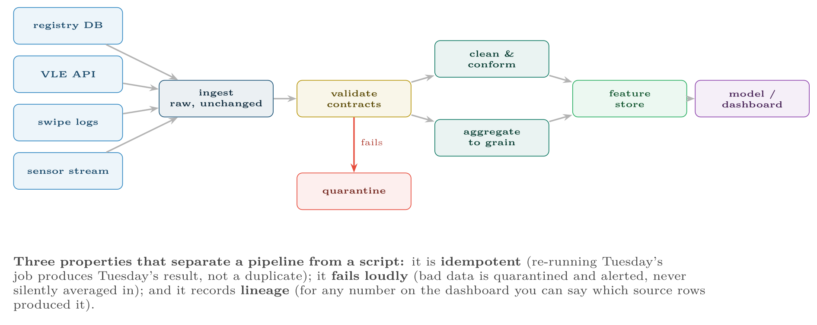
A data pipeline as a DAG
FIGURE 23.1
The quarantine branch is the part beginners omit and the part that saves projects: data that fails validation must stop, not flow onwards.
Data Science · Chapter 23 · Data Engineering at Scale
§23.2 · Handout p. 150 9
Notes:
Figure 23.1 (handout p. 151): A data pipeline as a DAG. The quarantine branch is the part beginners omit and the part that saves projects: data that fails validation must stop, not flow onwards.

Slide 10
ETL versus ELT
DEFINITION
ETL: Extract, Transform, then Load — transform before storing, so the warehouse holds only clean, modelled data. ELT: Extract, Load, then Transform — land the raw data first and transform inside the destination system. ELT dominates modern practice because storage is cheap and keeping the raw data lets you re-derive everything when requirements change.
Data Science · Chapter 23 · Data Engineering at Scale
§23.2 · Handout p. 150 10
Notes:
Read the box aloud, then ask for an example from the room before moving on.

Slide 11
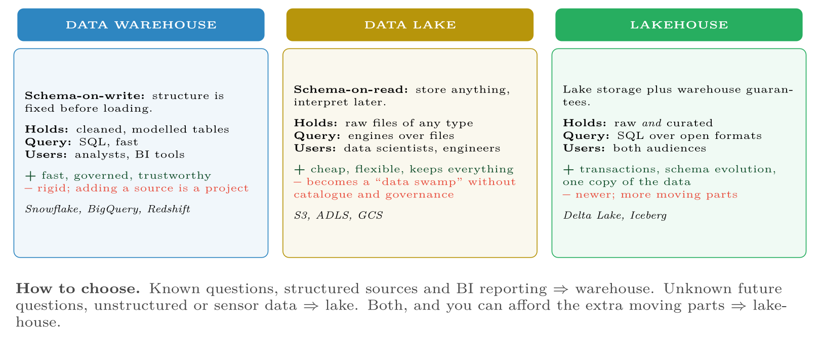
Warehouse, lake and lakehouse
FIGURE 23.2
The real distinction is when you commit to a schema — before loading, or at query time — and that choice determines how expensive it is to change your mind later.
Data Science · Chapter 23 · Data Engineering at Scale
§23.3 · Handout p. 151 11
Notes:
Figure 23.2 (handout p. 151): Warehouse, lake and lakehouse. The real distinction is when you commit to a schema — before loading, or at query time — and that choice determines how expensive it is to change your mind later.

Slide 12
Big Data: The Five V’s
SECTION 4 OF 6
23.4
23.1 Why Data Engineering Exists
23.2 Pipelines
23.3 Where Data Lives
23.4 Big Data: The Five V’s
23.5 Parallelism and Partitioning
23.6 Data Contracts and Automated Quality
Data Science · Chapter 23
Handout §23.4 12
Notes:
Pause. Name the question this section answers.

Slide 13

Big Data: The Five V’s
AT A GLANCE
V | Meaning | What it forces you to do
Volume | More data than one machine holds | Partition across machines; move the computation to the data, not the reverse
Velocity | Arriving faster than batch can absorb | Stream processing and windowing (Chapter 19)
Variety | Structured, semi-structured and unstructured together | Schema-on-read; a lake rather than a warehouse
Veracity | Quality varies and cannot be assumed | Automated validation, quarantine, lineage
Value | Most of it is never used | Prioritise ruthlessly; storage is cheap but attention is not
Data Science · Chapter 23 · Data Engineering at Scale
§23.4 · Handout p. 151 13
Notes:
Do not read the table row by row: pick the row the room is most likely to get wrong and ask why.

Slide 14

“Big Data” Is Rarer Than Claimed
WATCH OUT
A dataset is big when it does not fit on one machine. A year of records for 2,000 students is a few hundred megabytes and belongs in pandas, not in Spark. Reaching for distributed tooling on data that fits in memory adds days of complexity for negative benefit. Measure first.
Data Science · Chapter 23 · Data Engineering at Scale
§23.4 · Handout p. 151 14
Notes:
Read the box aloud, then ask for an example from the room before moving on.

Slide 15
Parallelism and Partitioning
SECTION 5 OF 6
23.5
23.1 Why Data Engineering Exists
23.2 Pipelines
23.3 Where Data Lives
23.4 Big Data: The Five V’s
23.5 Parallelism and Partitioning
23.6 Data Contracts and Automated Quality
Data Science · Chapter 23
Handout §23.5 15
Notes:
Pause. Name the question this section answers.

Slide 16
Partitioning
DEFINITION
Split data into independent chunks — by date, by device, by region — so that each can be processed on a different machine simultaneously, and so that a query for one day reads one partition instead of the whole dataset.
Data Science · Chapter 23 · Data Engineering at Scale
§23.5 · Handout p. 152 16
Notes:
Read the box aloud, then ask for an example from the room before moving on.

Slide 17
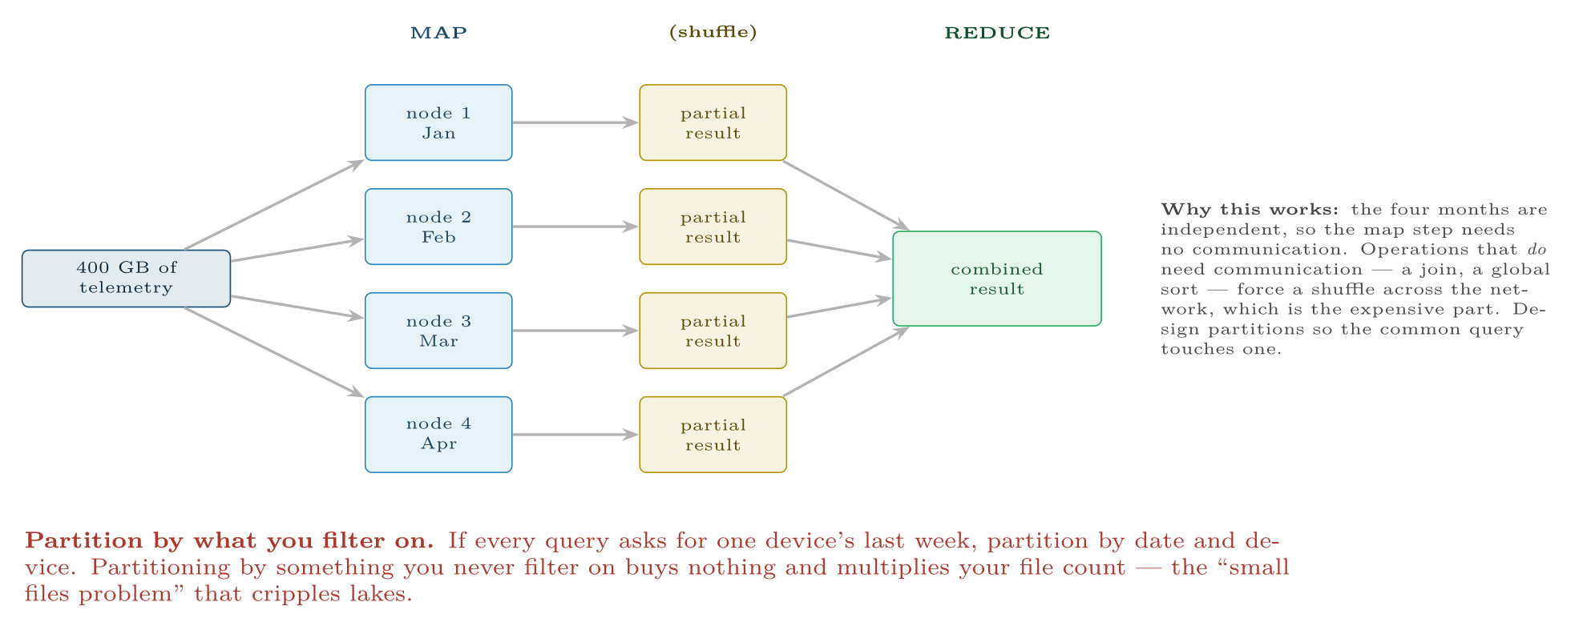
Map–reduce over partitioned data
FIGURE 23.3
Spark is a modern, in-memory implementation of this idea; the principle — split, compute independently, combine — is what makes data larger than one machine tractable.
Data Science · Chapter 23 · Data Engineering at Scale
§23.5 · Handout p. 152 17
Notes:
Figure 23.3 (handout p. 152): Map–reduce over partitioned data. Spark is a modern, in-memory implementation of this idea; the principle — split, compute independently, combine — is what makes data larger than one machine tractable.

Slide 18
Data Contracts and Automated Quality
SECTION 6 OF 6
23.6
23.1 Why Data Engineering Exists
23.2 Pipelines
23.3 Where Data Lives
23.4 Big Data: The Five V’s
23.5 Parallelism and Partitioning
23.6 Data Contracts and Automated Quality
Data Science · Chapter 23
Handout §23.6 18
Notes:
Pause. Name the question this section answers.

Slide 19
Data Contract
DEFINITION
An explicit, versioned agreement between a data producer and its consumers: which fields exist, their types, their permitted ranges, their nullability, and the freshness guarantee. Enforced automatically at ingestion, it converts a silent breakage into a loud, attributable failure.
Data Science · Chapter 23 · Data Engineering at Scale
§23.6 · Handout p. 152 19
Notes:
Read the box aloud, then ask for an example from the room before moving on.

Slide 20

Writing Checks That Would Have Caught Real Failures
WORKED EXAMPLE
Each check below corresponds to a failure from the audit in Chapter 3.
Dimension | Automated check | Action on failure
Completeness | null_rate(prior_qual) < 0.40 | warn; block if >0.6
Validity | final_grade IN (A,B,C,D,F) | quarantine the rows
Accuracy | age BETWEEN 15 AND 90 | quarantine, alert owner
Uniqueness | count(*) = count(DISTINCT student_id, term) | block the run
Timeliness | max(loaded_at) > now() - 26h | page on-call
Consistency | |registry_count − vle_count| < 50 | warn
Volume | row_count within ±30% of the 7-day median | block the run
Data Science · Chapter 23 · Data Engineering at Scale
§23.6 · Handout p. 152 20
Notes:
Each click adds one step of the working. Ask for the next number before you reveal it.

Slide 21
Writing Checks That Would Have Caught Real Failures (continued)
WORKED EXAMPLE
The last check is the most valuable and the least obvious. A source that silently starts returning 10% of its usual rows breaks no type and violates no range — every individual row is valid. Only the row count reveals it, and without that check the model quietly trains on a biased tenth of the population. Volume anomaly detection is the cheapest high-value check in any pipeline.
Data Science · Chapter 23 · Data Engineering at Scale
§23.6 · Handout p. 152 21
Notes:
Each click adds one step of the working. Ask for the next number before you reveal it.

Slide 22





Four lenses: Data Engineering
FOUR LENSES
LEARNING ANALYTICS
PROJECT MANAGEMENT
Sources are the registry (nightly batch), the VLE (API, hourly) and swipe readers (near real time).
Volumes are trivial — everything fits in a spreadsheet — so the engineering problem is not scale but integration.
INTERNET OF THINGS
CYBERSECURITY
The genuine big-data case in this course: 400 devices × 6 sensors × 1 Hz is 200 million rows a day.
Log volumes are enormous and retention is often mandated by regulation, so the lake pattern dominates: land everything raw, index selectively.
Data Science · Chapter 23 · Data Engineering at Scale
Handout p. 155 22
Notes:
The same method, four domains. Each of the next four slides opens one lens in full.

Slide 23

Learning Analytics: Data Engineering
FOUR LENSES
LEARNING ANALYTICS
Project Management
Sources are the registry (nightly batch), the VLE (API, hourly) and swipe readers (near real time). Grain conflicts are the recurring problem: registry is one row per enrolment, VLE is one row per click. Land both raw, then build a conformed weekly student table. Governance is unusually strict: this is personal data about identifiable young people, so lineage is not merely good practice but a requirement (Chapter 28).
Internet of Things
Cybersecurity
Data Science · Chapter 23 · Data Engineering at Scale
Handout p. 155 23
Notes:
Learning Analytics. Sources are the registry (nightly batch), the VLE (API, hourly) and swipe readers (near real time). Grain conflicts are the recurring problem: registry is one row per enrolment, VLE is one row per click. Land both raw, then build a conformed weekly student table. Governance is unusually strict: this is personal data about identifiable young people, so lineage is not merely good practice but a requirement (Chapter 28).

Slide 24

Project Management: Data Engineering
FOUR LENSES
PROJECT MANAGEMENT
Learning Analytics
Volumes are trivial — everything fits in a spreadsheet — so the engineering problem is not scale but integration. Ticket tracker, git, timesheets and CI logs each identify the same work item differently, and reconciling those identifiers is most of the work. A data contract with each tool’s owner is worth more here than any distributed technology.
Internet of Things
Cybersecurity
Data Science · Chapter 23 · Data Engineering at Scale
Handout p. 155 24
Notes:
Project Management. Volumes are trivial — everything fits in a spreadsheet — so the engineering problem is not scale but integration. Ticket tracker, git, timesheets and CI logs each identify the same work item differently, and reconciling those identifiers is most of the work. A data contract with each tool’s owner is worth more here than any distributed technology.

Slide 25

Internet of Things: Data Engineering
FOUR LENSES
INTERNET OF THINGS
Learning Analytics
The genuine big-data case in this course: 400 devices × 6 sensors × 1 Hz is 200 million rows a day. Partition by date and device, store in a columnar format, and pre-aggregate to minute and hour grains — almost no query needs raw 1 Hz data. Expect duplicates from at-least-once delivery and out-of-order arrival from network delay, so ingestion must be idempotent and windowing must use watermarks (Chapter 19).
Project Management
Cybersecurity
Data Science · Chapter 23 · Data Engineering at Scale
Handout p. 155 25
Notes:
Internet of Things. The genuine big-data case in this course: 400 devices × 6 sensors × 1 Hz is 200 million rows a day. Partition by date and device, store in a columnar format, and pre-aggregate to minute and hour grains — almost no query needs raw 1 Hz data. Expect duplicates from at-least-once delivery and out-of-order arrival from network delay, so ingestion must be idempotent and windowing must use watermarks (Chapter 19).

Slide 26

Cybersecurity: Data Engineering
FOUR LENSES
CYBERSECURITY
Learning Analytics
Log volumes are enormous and retention is often mandated by regulation, so the lake pattern dominates: land everything raw, index selectively. Two engineering requirements are specific to this domain — logs must be tamper-evident, because an attacker’s first act is to alter them, and lineage must be strong enough to stand up in an investigation. Ingestion latency is itself a security control: a detection pipeline with a six-hour lag cannot stop anything.
Project Management
Internet of Things
Data Science · Chapter 23 · Data Engineering at Scale
Handout p. 155 26
Notes:
Cybersecurity. Log volumes are enormous and retention is often mandated by regulation, so the lake pattern dominates: land everything raw, index selectively. Two engineering requirements are specific to this domain — logs must be tamper-evident, because an attacker’s first act is to alter them, and lineage must be strong enough to stand up in an investigation. Ingestion latency is itself a security control: a detection pipeline with a six-hour lag cannot stop anything.

Slide 27

Try it yourself: A Pipeline Task with Contracts
TRY IT YOURSELF
THIS WEEK'S LAB
WHAT YOU WILL RUN
Week 14: Data contracts; containerise a model
1 listing, 52 lines of Python
Data Science · Chapter 23 · Data Engineering at Scale
§23.6 · Handout p. 152 27
Notes:
Say what the room will have at the end of the lab, then let them start. Circulate rather than lecture.

Slide 28
A Pipeline Task with Contracts
LAB · STEP 1 OF 4
Set-up
Python
1
2
3
4
5
6
7
8
9
10
11
12
13
14
import pandas as pd
from datetime import datetime, timedelta
class DataContractViolation(Exception):
pass
CONTRACT = {
"required": ["student_id", "term", "attendance_pct", "loaded_at"],
"ranges": {"attendance_pct": (0, 100), "age": (15, 90)},
"allowed": {"final_grade": {"A", "B", "C", "D", "F"}},
"unique_on": ["student_id", "term"],
"max_null": {"prior_qualification": 0.40},
"freshness_hours": 26,
}
Data Science · Chapter 23 · Data Engineering at Scale
§23.6 · Handout p. 152 28
Notes:
Step 1: Set-up. Read the code aloud; ask what each line would print before running it.

Slide 29
A Pipeline Task with Contracts
LAB · STEP 2 OF 4
Python
15
16
17
18
19
20
21
22
23
24
25
26
def validate(df, contract=CONTRACT):
"""Returns (clean_rows, quarantined_rows). Blocks on structural failures."""
missing = set(contract["required"]) - set(df.columns)
if missing:
raise DataContractViolation(f"missing required columns: {missing}")
if df.duplicated(contract["unique_on"]).any():
raise DataContractViolation("uniqueness violated -- run blocked")
age = (datetime.now() - df["loaded_at"].max()).total_seconds() / 3600
if age > contract["freshness_hours"]:
raise DataContractViolation(f"stale data: {age:.1f}h old")
Data Science · Chapter 23 · Data Engineering at Scale
§23.6 · Handout p. 152 29
Notes:
Read the code aloud; ask what each line would print before running it.

Slide 30
A Pipeline Task with Contracts
LAB · STEP 3 OF 4
Python
27
28
29
30
31
32
33
34
35
36
37
38
39
bad = pd.Series(False, index=df.index)
for col, (lo, hi) in contract["ranges"].items():
if col in df:
bad |= ~df[col].between(lo, hi) & df[col].notna()
for col, allowed in contract["allowed"].items():
if col in df:
bad |= ~df[col].isin(allowed) & df[col].notna()
for col, limit in contract["max_null"].items():
if col in df and df[col].isna().mean() > limit:
print(f"WARN: {col} is {df[col].isna().mean():.0%} null (limit {limit:.0%})")
return df[~bad], df[bad] # quarantine, never silently drop
Data Science · Chapter 23 · Data Engineering at Scale
§23.6 · Handout p. 152 30
Notes:
Read the code aloud; ask what each line would print before running it.

Slide 31
A Pipeline Task with Contracts
LAB · STEP 4 OF 4
Python
40
41
42
43
44
45
46
47
48
49
def check_volume(df, history_median, tolerance=0.30):
"""The cheapest high-value check: did the source quietly shrink?"""
ratio = len(df) / history_median
if abs(ratio - 1) > tolerance:
raise DataContractViolation(
f"row count {len(df)} is {ratio:.0%} of the 7-day median -- run blocked")
# clean, quarantined = validate(raw_df)
# check_volume(clean, history_median=1987)
# quarantined.to_parquet(f"quarantine/{datetime.now():%Y-%m-%d}.parquet")
Data Science · Chapter 23 · Data Engineering at Scale
§23.6 · Handout p. 152 31
Notes:
Read the code aloud; ask what each line would print before running it.

Slide 32

What does it mean for a pipeline task to be idempotent, and why does it matter when a job is re-run after a failure?
CHECKPOINT 1 OF 3
Discuss with the person next to you, then advance.
Data Science · Chapter 23 · Data Engineering at Scale
Handout p. 155 · answers in Appendix D 32
Notes:
Ask the room. Do not advance until someone commits to an answer.

Slide 33

What does it mean for a pipeline task to be idempotent, and why does it matter when a job is re-run after a failure?
CHECKPOINT 1 OF 3 · ANSWER
Idempotent means re-running a task produces the same result rather than duplicating or compounding its effect. It matters because failures are normal: a job that half-completed must be safe to re-run without producing double-counted rows.
Data Science · Chapter 23 · Data Engineering at Scale
Handout p. 155 · answers in Appendix D 33
Notes:
Answer (Appendix D): Idempotent means re-running a task produces the same result rather than duplicating or compounding its effect. It matters because failures are normal: a job that half-completed must be safe to re-run without producing double-counted rows.

Slide 34
Your dataset is 300 MB. Should you use Spark? Justify.
CHECKPOINT 2 OF 3
Discuss with the person next to you, then advance.
Data Science · Chapter 23 · Data Engineering at Scale
Handout p. 155 · answers in Appendix D 34
Notes:
Ask the room. Do not advance until someone commits to an answer.

Slide 35
Your dataset is 300 MB. Should you use Spark? Justify.
CHECKPOINT 2 OF 3 · ANSWER
No. 300 MB fits comfortably in memory; pandas will be faster to write, faster to run and far easier to debug. Distributed tooling on small data adds days of complexity for negative benefit.
Data Science · Chapter 23 · Data Engineering at Scale
Handout p. 155 · answers in Appendix D 35
Notes:
Answer (Appendix D): No. 300 MB fits comfortably in memory; pandas will be faster to write, faster to run and far easier to debug. Distributed tooling on small data adds days of complexity for negative benefit.

Slide 36
A source silently starts returning 10% of its usual rows. Which of the six quality dimensions catches this, and which check specifically?
CHECKPOINT 3 OF 3
Discuss with the person next to you, then advance.
Data Science · Chapter 23 · Data Engineering at Scale
Handout p. 155 · answers in Appendix D 36
Notes:
Ask the room. Do not advance until someone commits to an answer.

Slide 37
A source silently starts returning 10% of its usual rows. Which of the six quality dimensions catches this, and which check specifically?
CHECKPOINT 3 OF 3 · ANSWER
Completeness, caught by the row-count / volume check against a rolling median. Every individual row is valid, so type, range and null checks all pass — only the count reveals it.
Data Science · Chapter 23 · Data Engineering at Scale
Handout p. 155 · answers in Appendix D 37
Notes:
Answer (Appendix D): Completeness, caught by the row-count / volume check against a rolling median. Every individual row is valid, so type, range and null checks all pass — only the count reveals it.

Slide 38

What to take away
CHAPTER SUMMARY
1
Pipelines are DAGs of scheduled tasks; they must be idempotent, fail loudly and record lineage.
2
ELT has largely displaced ETL because cheap storage makes keeping the raw data worthwhile.
3
Warehouses fix the schema on write, lakes on read, lakehouses attempt both. The choice is about when you commit.
4
The five V’s each impose a technical requirement; veracity is the one most often ignored.
5
Partition by what you filter on. Shuffles across the network are the expensive operation.
6
Data contracts turn silent breakage into an attributable failure, and a row-count check is the cheapest valuable test you can write.
Data Science · Chapter 23 · Data Engineering at Scale
Handout p. 155 38
Notes:
Ask the room to say each takeaway before you reveal it.

Slide 39

Quick check 1 of 2
REVIEW · MULTIPLE CHOICE
Schema-on-read is characteristic of:
A
a data warehouse
B
a data lake
C
ETL
D
a relational database
Data Science · Chapter 23 · Data Engineering at Scale
Handout p. 155 39
Notes:
Take a show of hands for each option before discussing. (The handout does not print MCQ answers.)

Slide 40
Quick check 2 of 2
REVIEW · MULTIPLE CHOICE
Which operation forces an expensive network shuffle?
A
filtering one partition
B
a per-row transformation
C
a join across partitions
D
reading a column
Data Science · Chapter 23 · Data Engineering at Scale
Handout p. 155 40
Notes:
Take a show of hands for each option before discussing. (The handout does not print MCQ answers.)

Slide 41
For your notebook
REVIEW QUESTIONS
SHORT
Define idempotence and give an example of a non-idempotent pipeline step and its consequence.
SHORT
Explain why a quarantine branch is preferable to dropping invalid rows.
SHORT
Why is ingestion latency a security control in a detection pipeline?
APPLIED
Design the ingestion layer for 400 IoT devices reporting 6 channels at 1 Hz. Specify the storage format, partitioning scheme, aggregation grains, and how you handle duplicates and late arrivals.
APPLIED
Write six data-contract checks for a nightly student enrolment feed, stating for each whether failure should warn, quarantine or block the run — and justify the three that block.
Data Science · Chapter 23 · Data Engineering at Scale
Handout p. 155 41
Notes:
Set these for independent study. Model answers are not printed in the handout.

Slide 42
End of Chapter 23
23
NEXT
READ
Chapter 24 — Cloud and Edge Computing for Data Science
Handout Chapter 23, pages 150–155
THIS WEEK'S LAB
ASSESSMENT
Data contracts; containerise a model
Capstone set
Data Science · Chapter 23 · Data Engineering at Scale
42
Notes:
Close. NEXT: Chapter 24 — Cloud and Edge Computing for Data Science. READ: Handout Chapter 23, pages 150–155. THIS WEEK'S LAB: Data contracts; containerise a model. ASSESSMENT: Capstone set.

